Slide 1

PROJECT:
Highway Bridges in U.S.

Slide 2

CONTENTS
01
Introduction
02
ERD
03
Problem
04
Interesting problem

Slide 3

INTRODUCTION
Part 01

Slide 4
Brief view of the project
Total data have 725590 rows and 135 columns.
01
A structure is an architectural structure, it can be a bridge or other type of building.
02
A route is a path that vehicle or other things can pass. Routes can be carried "on" and "under" a structure, and a structure can carry more than one route.
03
There are many reasons that influence the improvement cost--- the structure of bridge, the location, the traffic and etc.
04

Slide 5
The process of our project.
Figure out the aim of the project. Understand the meaning of each attributes. Find the relationship of the data.
01
Design the data model and load the data
02
Optimize the data and analyze the questions.
03

Slide 6
ERD
Part 02

Slide 7
Main reasons affecting improvement cost
01
Structure
Material type
Design type
Type of Service
02
Traffic
ADT
Traffic lanes
Traffic direction
02
03
highway
a. National network
b. Highway system

Slide 8
Main reasons affecting improvement cost
04
Ratings
Condition rating
Appraisal rating
05
Other
reasons
History
Year of Reconstruction
Deck protection
…
02

Slide 9
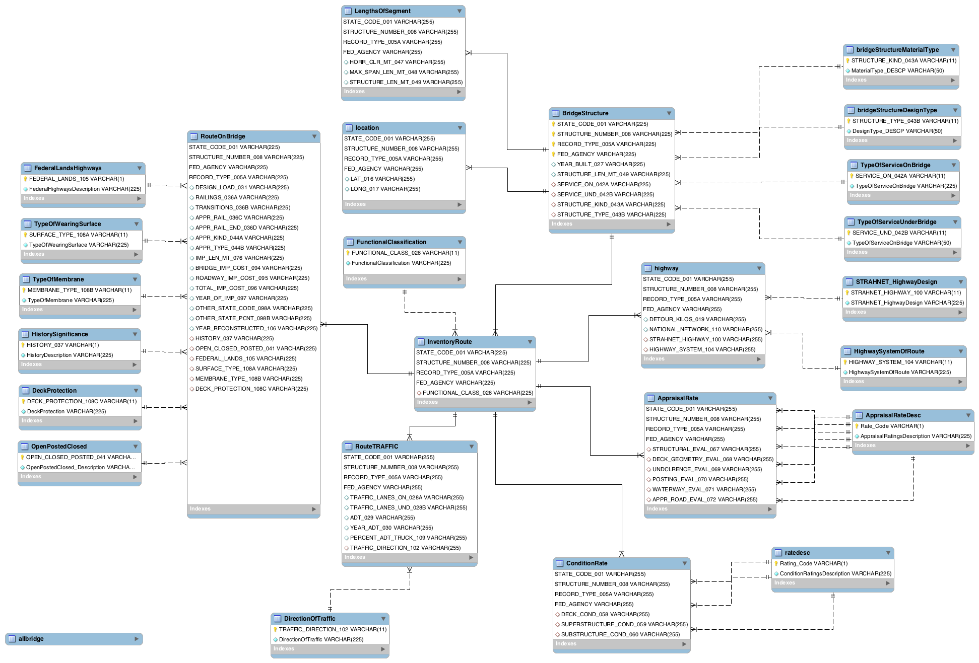
02 ERD – Overview
The whole structure of our ERD.

Slide 10
02 ERD – Overview
The whole structure of our ERD.

Slide 11
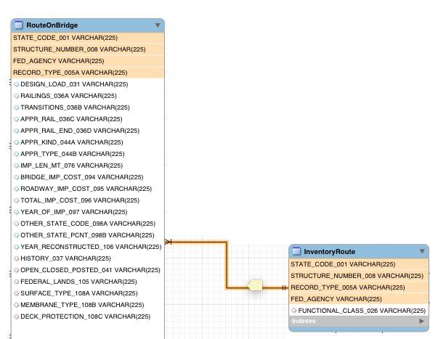
02 ERD
Two important entities
1. Inventory route
2. Bridge Structure

Slide 12
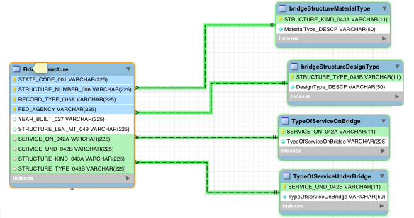
02 ERD-structure
a. Material type
b. Design type
c. Type of Service

Slide 13
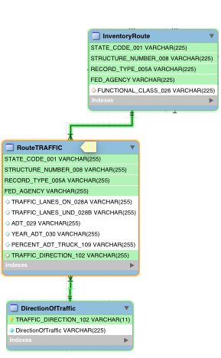
02 ERD-traffic
a. ADT
b. Traffic lanes
c. Traffic direction

Slide 14
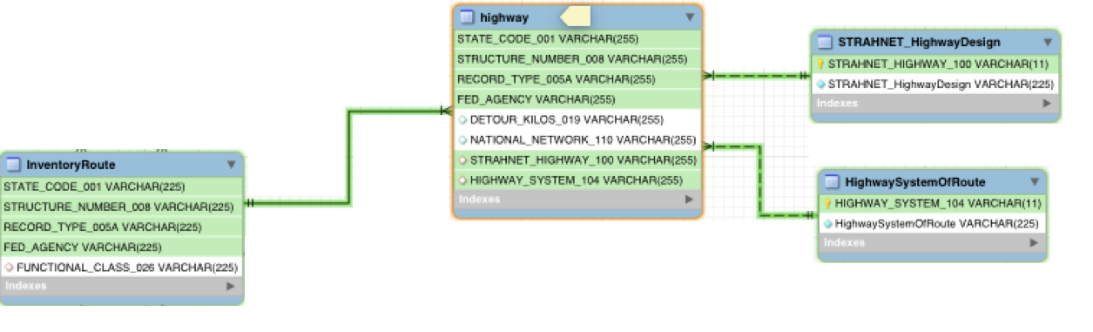
02 ERD-highway
a. National network
b. Highway system

Slide 15
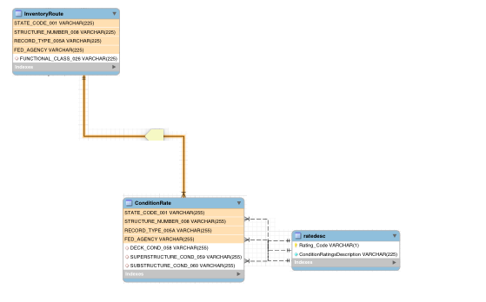
02 ERD-ratings
Ratings
1. Condition rating
2. Appraisal rating

Slide 16
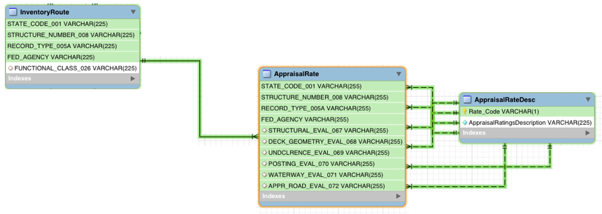
02 ERD-ratings
Ratings
1. Condition rating
2. Appraisal rating

Slide 17
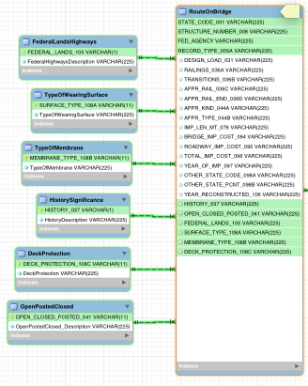
02 ERD-Other reasons
a. History
b. Year of Reconstruction
c. Deck protection
…

Slide 18
Problem
Part 03

Slide 19


Problem:
To get the year of all states when the most bridges are built.
Result:

Slide 20
Problem:
To get the year of all states when the most bridges are built.
Optimize:
Creating index: reduce the time from 66.118s to 0.792s

Slide 21
Interesting Problem
Part 04

Slide 22
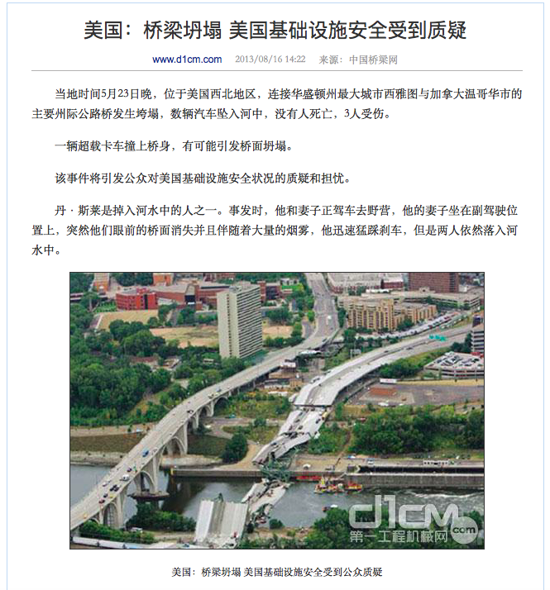

Interesting Problem

Slide 23
Interesting Problem
Which state has the maximum number of truck’s average daily traffic per bridge among bridge built after 2010 ?

Slide 24

Interesting Problem
Optimize:
Creating index

Slide 25
THANK YOU

